Slide 1
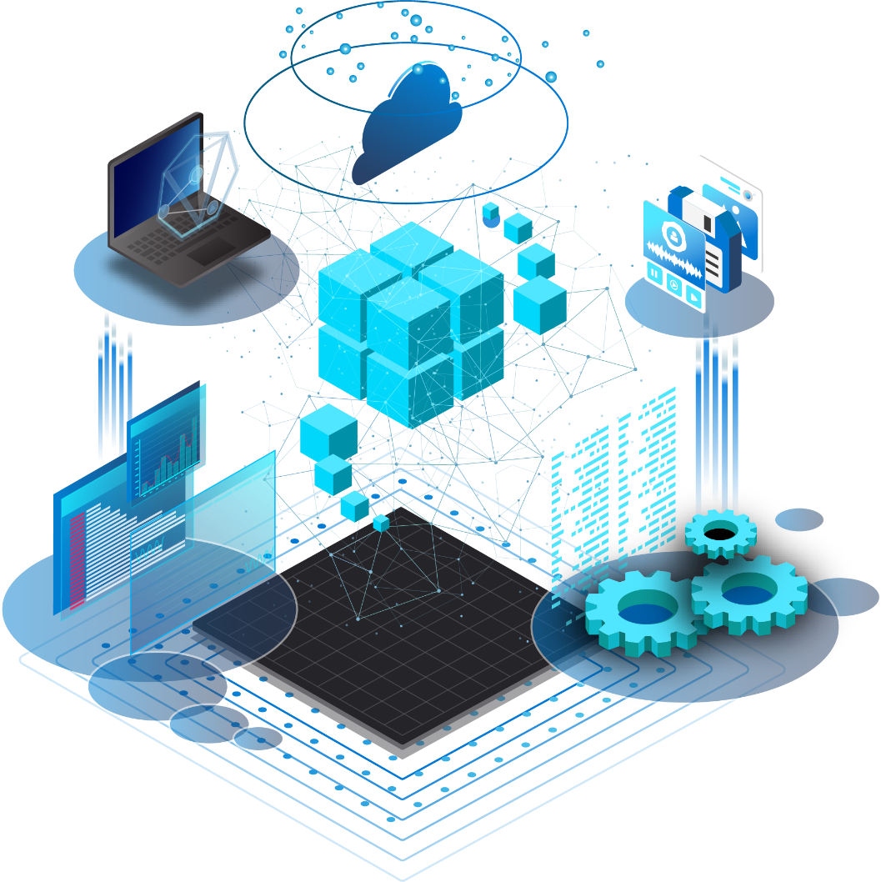
Synapse Link for SQL
L200 + L300 deck

Slide 2


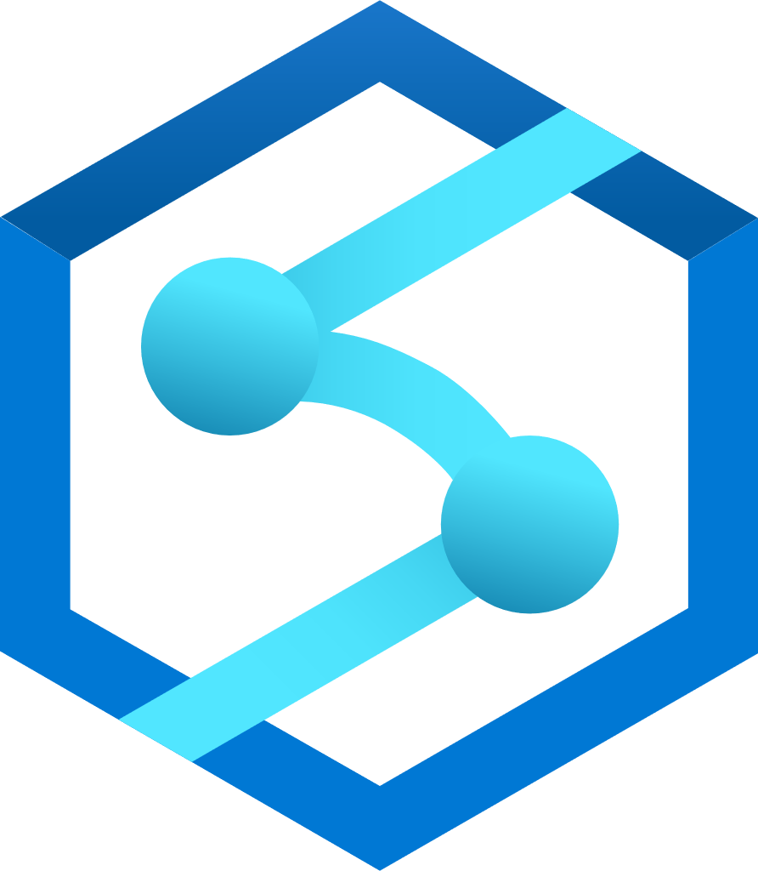

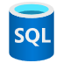
Synapse Link Offerings
Business Apps & Operational data stores
Machine learning
Dynamics 365
Big data analytics
Azure Cosmos DB
Azure Synapse Link
BI Dashboards
SQL
NOW
SQL DB/SQL Server
Azure Synapse Analytics

Slide 3
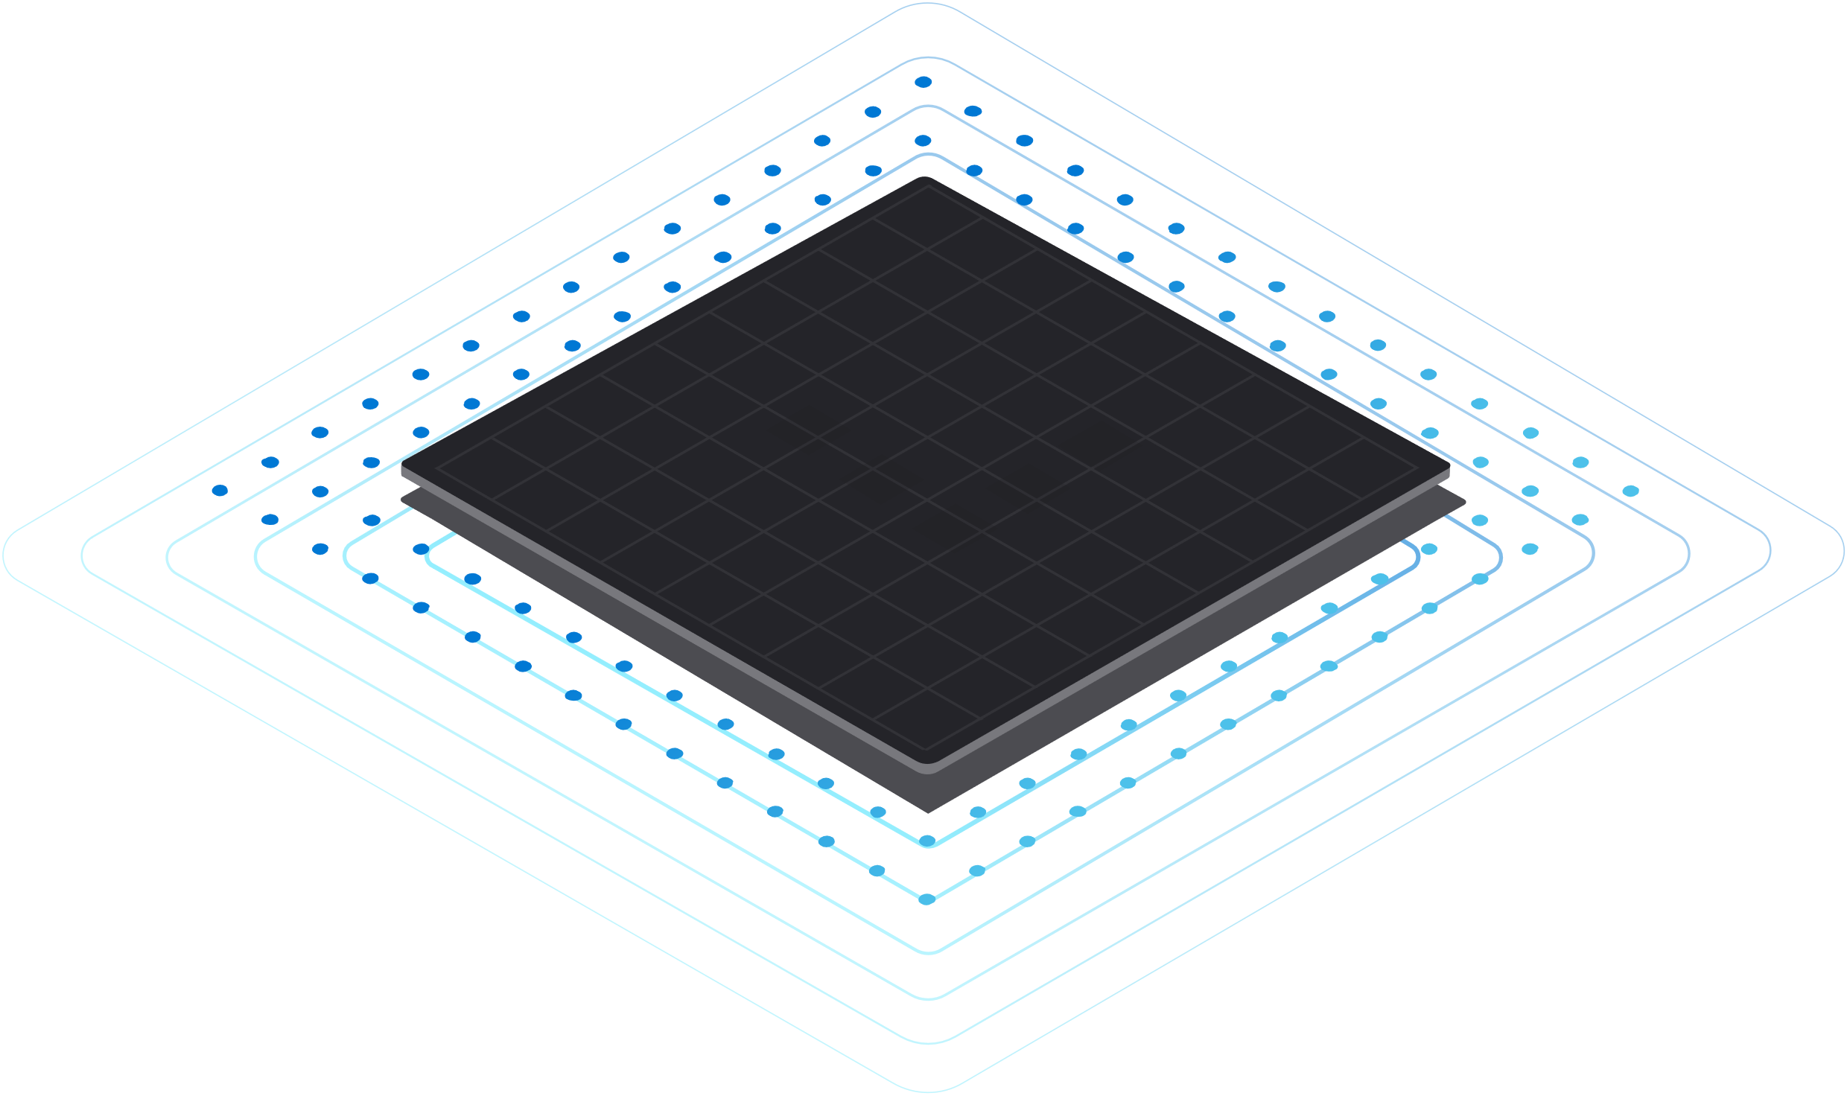
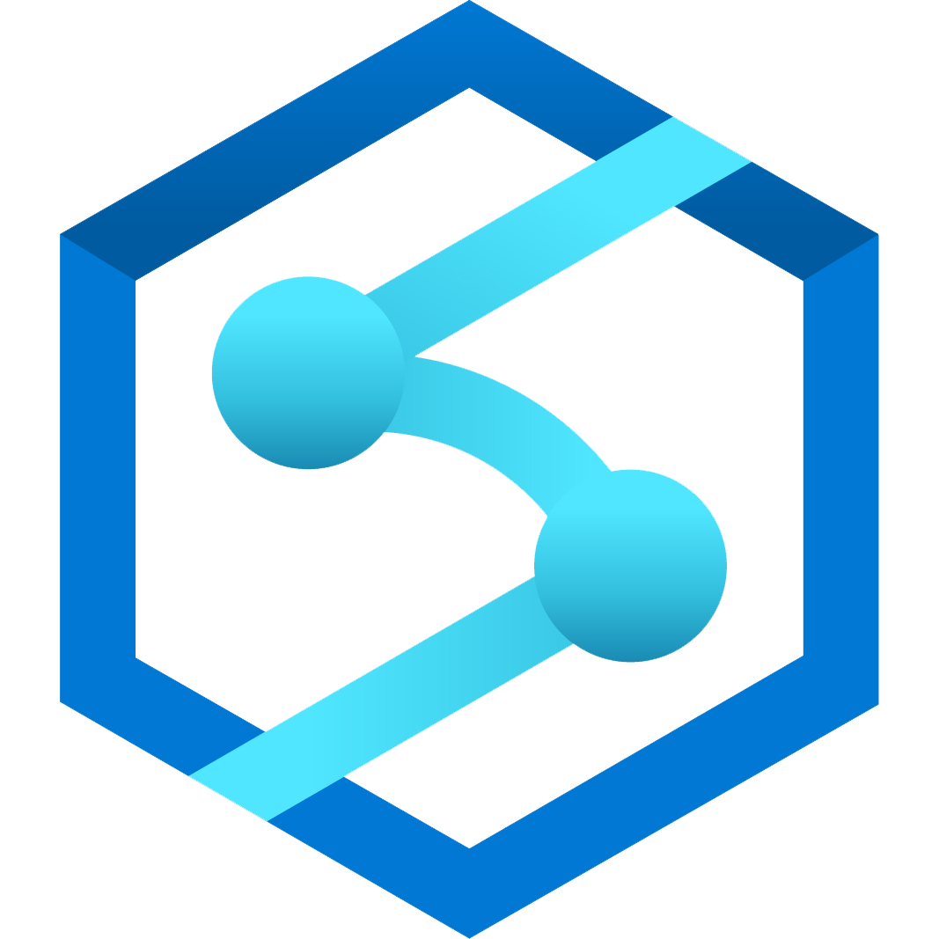
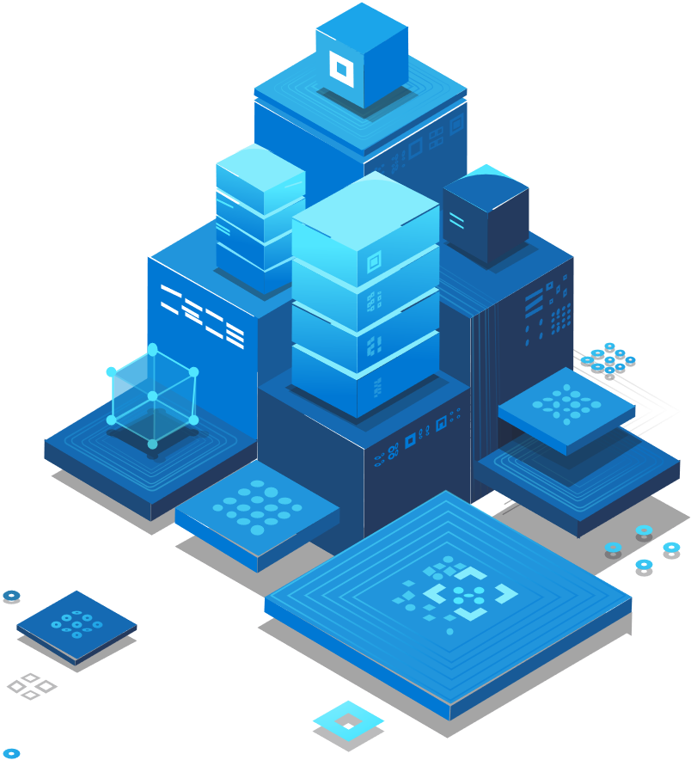
What is Azure Synapse Link for SQL?
Breaking down the barrier between OLTP and OLAP
Near real-time data analytics
No customer-managed ETL required
Built for convergence
1
Azure Synapse
Operational Databases

Slide 4
Azure Synapse Link for SQL
Empower near real time analytics over operational data in Azure SQL Database and SQL Server 2022.
ADX SQK Spark
Azure SQL Database & SQL Server 2022
Synapse SQL
Synapse Link for SQL
Azure Synapse Analytics
Minimum impact on operational workload → The latest SQL change feed technology
No custom ETL → fully managed experience to land operational data in Azure Synapse dedicated SQL pool
Near real-time insights into your operational data → Continuous data replication from Azure SQL DB or SQL Server 2022

Slide 5
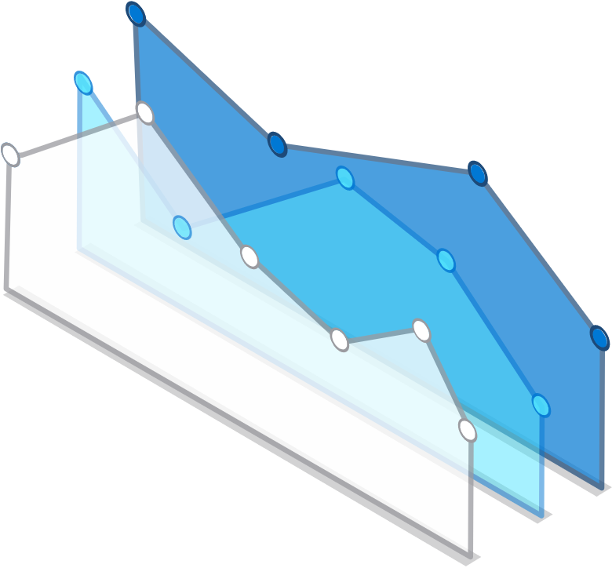
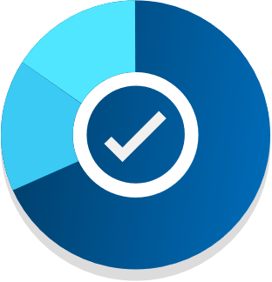

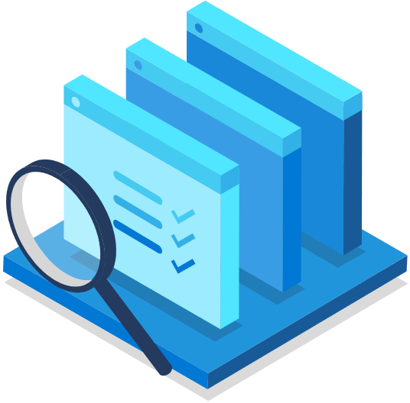

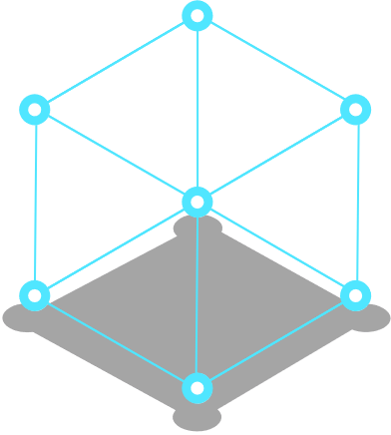


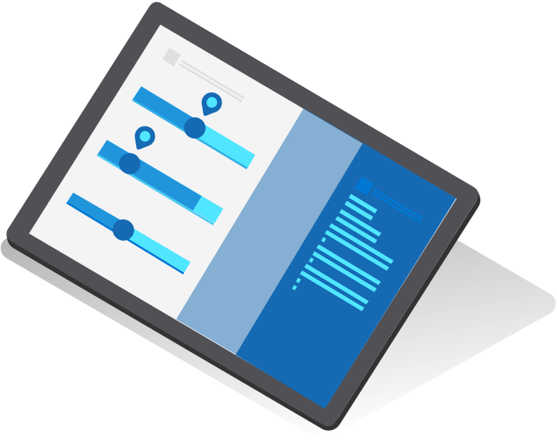
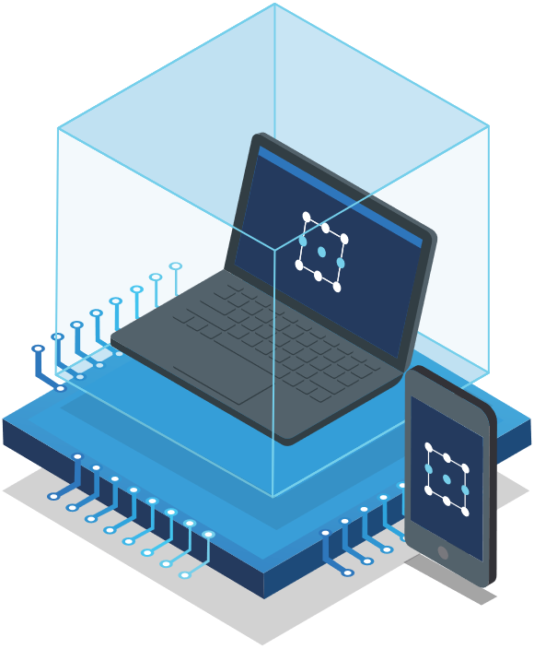

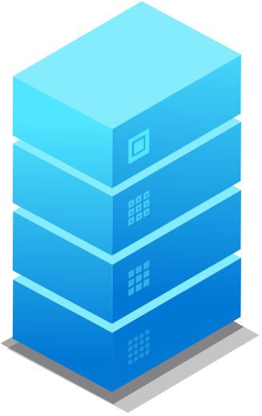
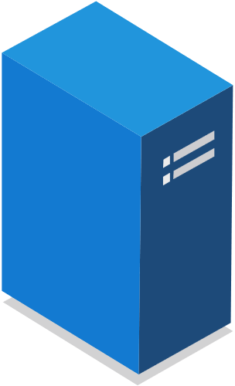

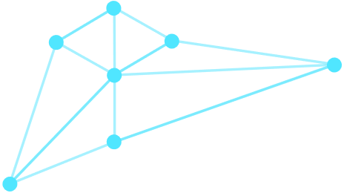



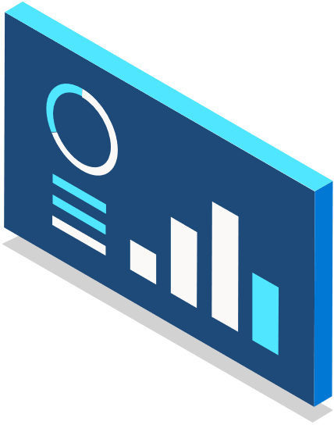

Azure Synapse Link for SQL – value prop
Faster time to insights
Low Code/No Code solution for data movement
Leverage the power of Azure Synapse Analytics against your operational data

Slide 6
Synapse Link for SQL – Core Concepts

Slide 7

Core Concepts
Source database:
Azure SQL Database
SQL Server 2022
Designation database:
Synapse dedicated SQL Pool
Link Connection: A mapping relationship between the source database (Azure SQL Database or SQL Server 2022) and an Azure Synapse dedicated SQL pool.
Landing Zone: An interim staging store for Azure Synapse Link for SQL. System-managed for Azure SQL Database. Customer-managed for SQL Server 2022.
Self-Hosted Integration Runtime (SQL Server 2022 only): A software agent that brokers communication between Azure Synapse Analytics and SQL Server 2022.

Slide 8
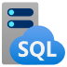
Synapse Link for SQL - Architecture
Landing Zone
Azure Synapse Link for SQL – SQL DB
SQL change feed
continually pushes
Ingestion service
Continuously running or Schedule Mode
Min 4 vCores
Azure SQL DB
ADLS Gen 2
Synapse dedicated SQL Pool
Landing Zone
Azure Synapse Link for SQL – SQL Server 2022
SQL change feed
continually pushes
Ingestion service
SQL Server 2022
Continuously running or Schedule Mode
Min 4 vCores
ADLS Gen 2
Synapse dedicated SQL Pool

Slide 9
Azure Synapse Link for SQL – more features
Fully Managed
Performant and enterprise ready
Interoperability Integrates with all Synapse capabilities
1:1 Mapping
Synapse link tables mirror the operational store with no data loss
Transactionally Consistent
Synapse Link Connections are updated within transactional boundaries
Supports PaaS, IaaS and on-premises

Slide 10
Key Limitations
Required use of dedicated SQL pool
DDL commands not supported, including
Add Column
Drop Column
Rename Column
Truncate Table
Switch Partition

Slide 11
Synapse Link for SQL Experience

Slide 12
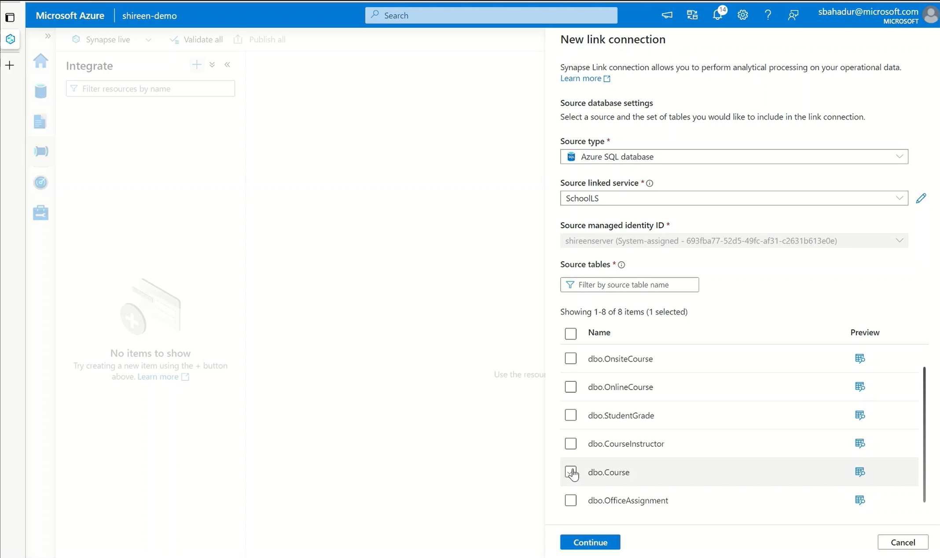
Choose your Source Tables
Upon creating a new link connection, you are easily able to choose which tables to bring in, along with previewing the data

Slide 13
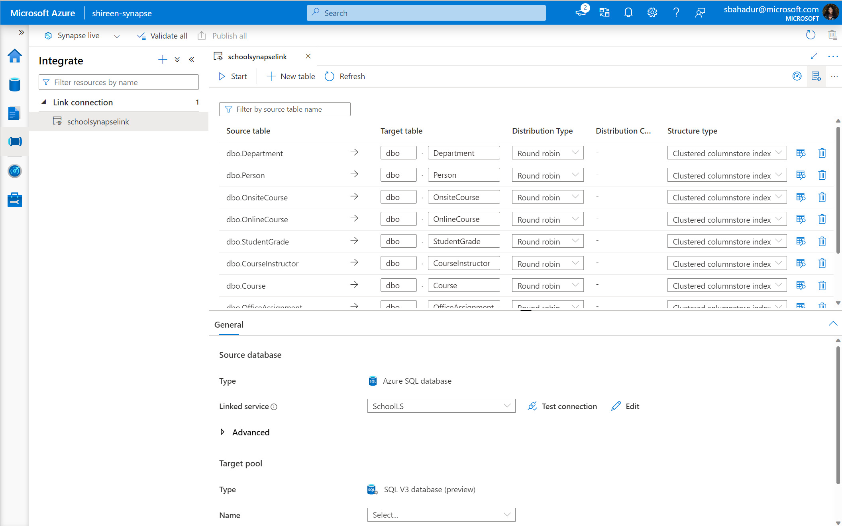
Customize your target tables
After selecting your tables, you are able to rename your tables in the dedicated SQL Pool, along with picking a distribution type and structure type

Slide 14
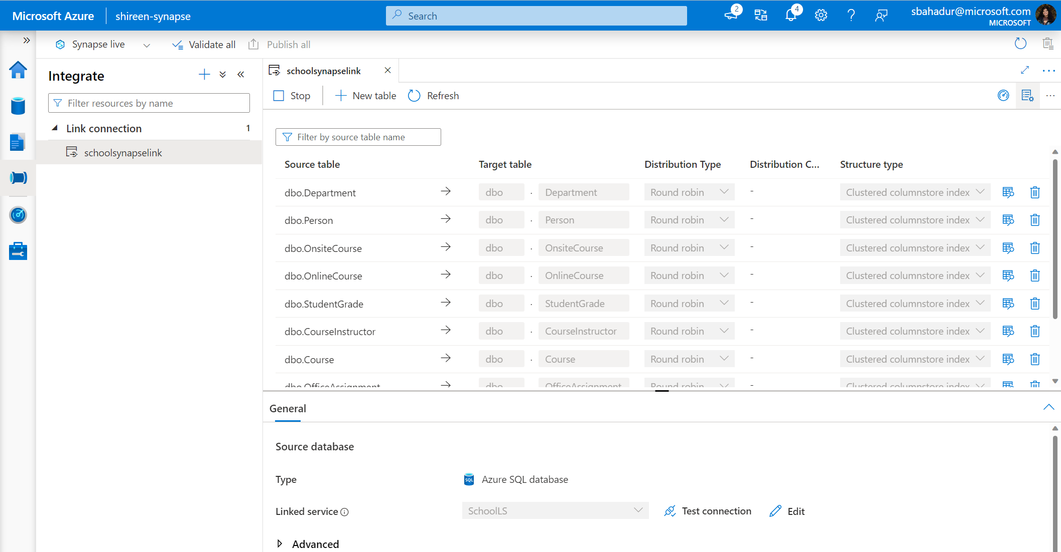
Continuous replication of data
Once the link connection is started, the tables will continuously replicate the data into the dedicated SQL Pool and detect any changes to the source data (INSERTS, UPDATES, and DELETES)

Slide 15
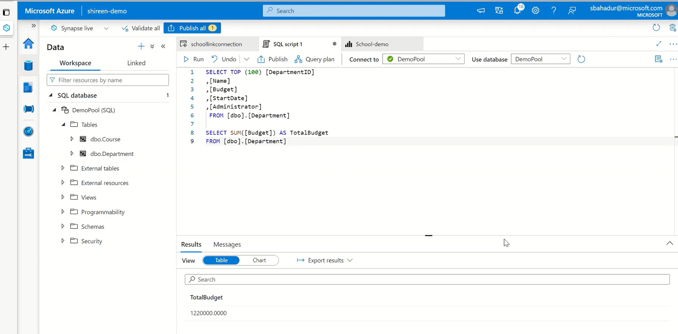
Run SQL queries on your replicated data
As the data is continuously replicating, you have the ability to run SQL queries on all the tables that have been brought into your dedicated SQL Pool

Slide 16
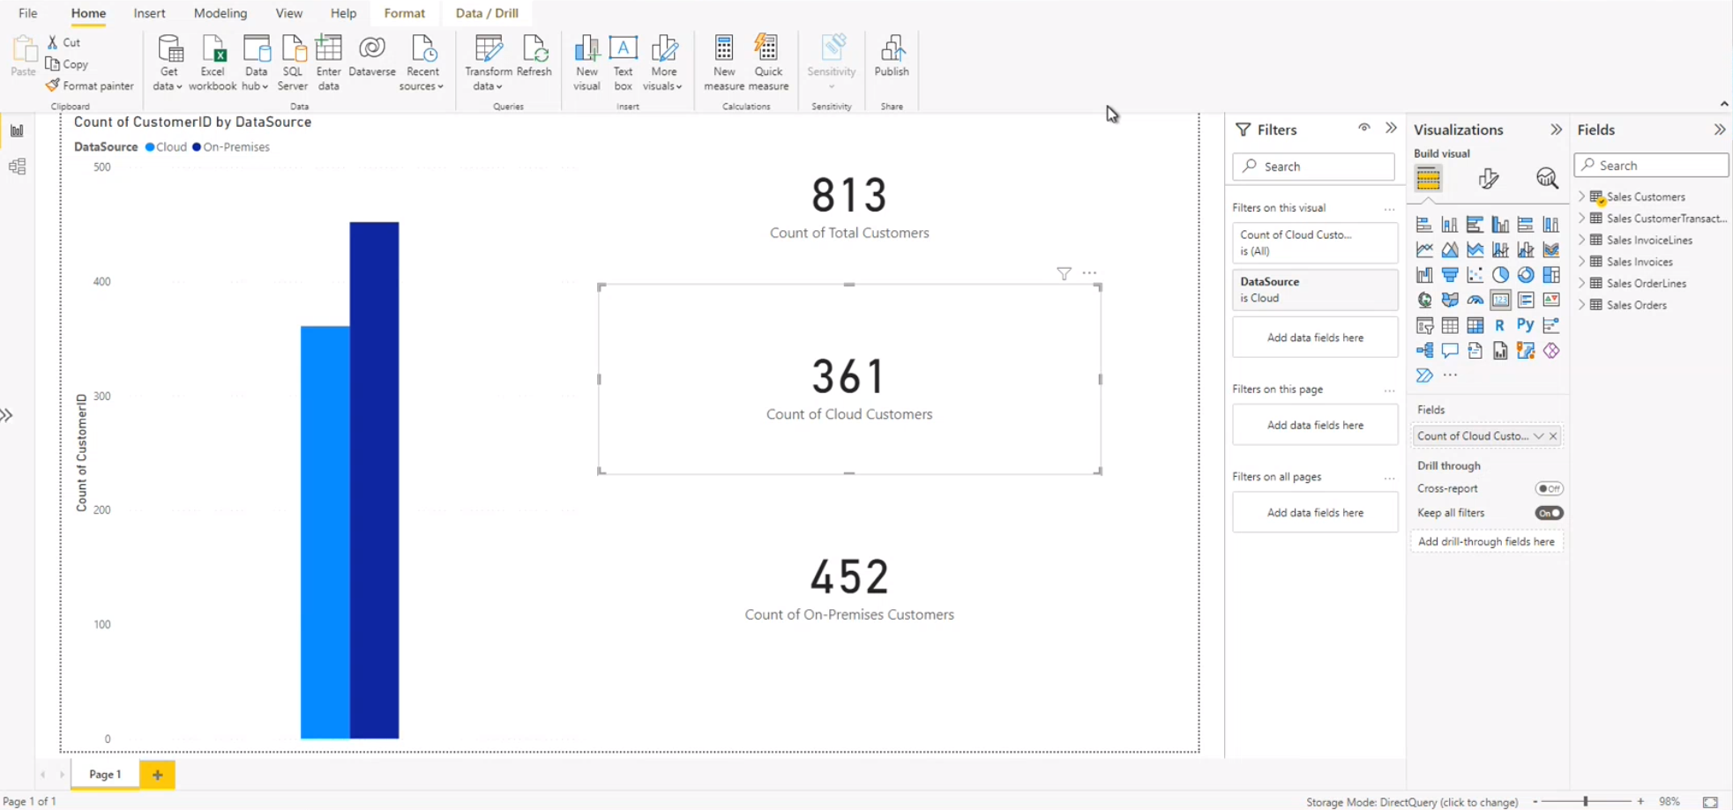
Connect to Power BI for your real-time reporting
You are able to connect Power BI to your dedicated SQL Pool and create reports and dashboards on your data for reporting and analytical purposes

Slide 17
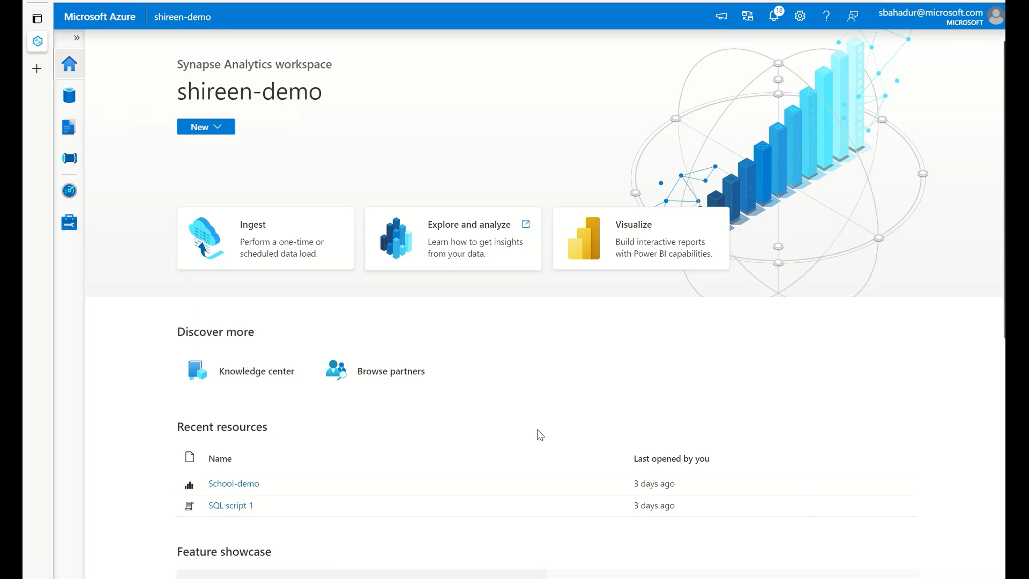
Demo: Setting up the link connection

Slide 18
Recent feature releases + roadmap

Slide 19
Azure Synapse Link for SQL: H1 FY23 updates
Single node cluster support
Security
UX improvement
Data type support
Four cores are now supported in a single node for improved cost optimization
Enable less-privileged setup by removing db_owner requirement
Ability to create dedicated SQL pools from within Synapse Link experience
Full fidelity for datetime2 and time data types
Live (SS22)
Live (SS22)
User defined latency
Live
Ability to schedule frequency of syncs up to 60 minutes apart
VNET support
Remove requirement to start from a new Synapse workspace
Live
Live
Previous updates

Slide 20
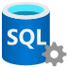


Synapse Link for SQL
Public Preview
Q2 CY 2022
SQL Server 2022 and Azure SQL Database
Near real-time operational analytics in Synapse
No need for data pipelines
Hybrid integration for SQL Server running on-premise or in other clouds
SQL Server 2022
Public Preview Q2 2022
Azure SQL Database
Public Preview Q2 2022

Slide 21
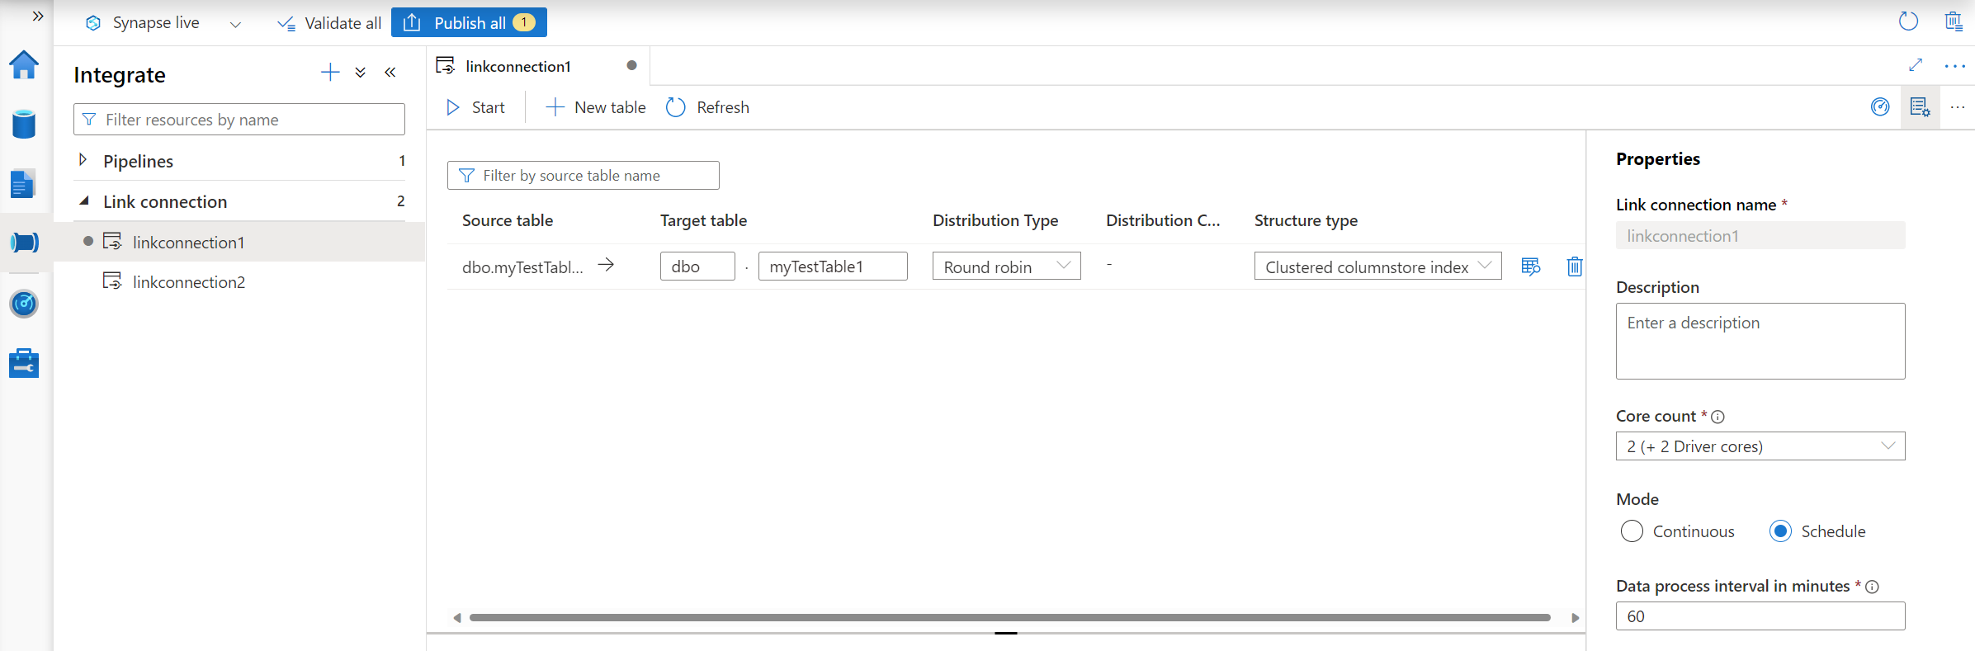
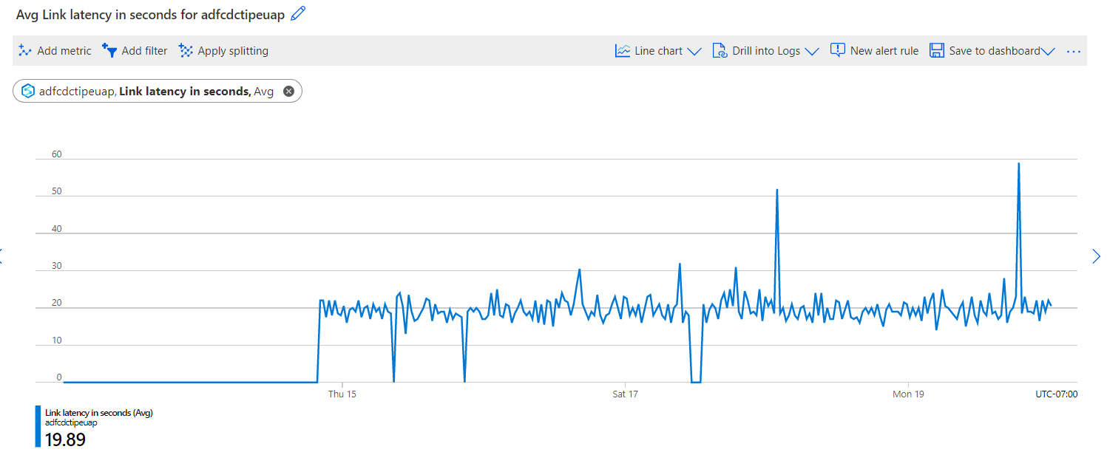
Synapse Link for SQL
Public Preview
SQL Server 2022 and Azure SQL Database
Azure Monitoring integration Ability to show historical trend of events, processed data volume and latency
Single node cluster support (for lesser cores) Four cores are now supported in a single node for improved cost optimization
User defined latency Ability to schedule frequency of syncs up to 60 minutes to optimize cost

Slide 22
Azure Synapse Link for SQL: Looking forward
Enterprise monitoring
Security
UX improvement
Cost optimization
Data type support
Azure Monitor integration
Enable less-privileged (Control Database) setup by removing db_owner requirement
Enable customers to easily discover Synapse Link for SQL in Azure SQL Database
Ability to pause and resume a link connection without restarting the initial load
Full fidelity for datetime2 and time data types
(Azure SQL)

Slide 23
Common Use Cases

Slide 24



Sample use case – Cross System reporting & Analytics
Pain Point: Data that is spread across multiple ERP systems across many different locations. Customer wants to run analytics on the data in one centralized location.
Use Case
Azure Synapse Analytics
ERP Client App – Azure SQL DB
Operational reporting
Azure Synapse Link for SQL
ERP Client App – On prem SQL Server 22
Azure Synapse Dedicated SQL Pool
Power BI
Customers/Viewers
ERP Client App – On prem SQL Server 22
Outcome – Use Synapse Link for SQL server on premises or SQL DB databases to bring all data into a common location (dedicated SQL Pool). Then, you can run queries on the data and visualize in Power BI in near real-time

Slide 25

Sample use case – Multi-tenancy reporting
Pain Point: Each customer has their own tenant but each customer has the ability to run analytics over all of the customer databases
Use Case
Operational reporting
Tenant A Users
Tenant A Database
Azure Synapse Analytics
Azure Synapse Link for SQL
Power BI
Tenant Application
Tenant B Database
Tenant B Users
Azure Synapse Dedicated SQL Pool
Tenant C Database
Tenant C Users
Tenants/Viewers
Outcome – Create a Synapse Link for SQL connection to each of the tenant databases. Then bring the data into a common location (dedicated SQL Pool) and then run analytics over the aggregated data

Slide 26
Other Use Cases
Cross-system reporting and analytics
Multi-tenancy reporting
Scenario – Data that is spread across multiple ERP systems across many different locations. Customer wants to run analytics on the data in one centralized location
Solution – Use Synapse Link for SQL server on premises or SQL DB databases to bring all data into a common location (dedicated SQL Pool). Then, you can run queries on the data and visualize in Power BI in near real-time
Scenario – Each customer has their own tenant but each customer has the ability to run analytics over all of the customer databases
Solution – Create a Synapse Link for SQL connection to each of the tenant databases. Then bring the data into a common location (dedicated SQL Pool) and then run analytics over the aggregated data

